Slide 1
Customizable Machine Monitoring and Control with Hazelcast Jet
Randy May
22 Apr, 2022

Slide 2
Agenda
Problem Statement (5 min)
Hazelcast Company and Platform Overview (8 min)
Hazelcast IMDG in Action , Demonstration (7 min)
How Hazelcast Does Event Processing (15 min)
Hazelcast Event Processing Demonstration (15 min)
Open Discussion and Next Steps (10 min)

Slide 3
Problem Statement

Slide 4
Problem Statement
Georgia Automation and Control is implementing a new solution targeted at small to medium factories. The solution will allow an unprecedented level of customization. Customers will be able to set their own alerts, design custom machine control policies and, with minimal help, incorporate new machine types.
They are looking for a robust, scalable event processing engine to be the foundation for their next generation solution.

Slide 5
Problem Statement
Flexibility. It should be possible to implement any policy that can be coded.
Low Latency. Not more than 1 second between stimulus and response.
Scalability. As sensors are added or upgraded, event volume will increase. The solution should scale out gracefully.
Fault Tolerance. Failure of one host must not result in missed signals.
Operates in remote locations outside of the cloud or corporate data center
outside connectivity may be limited or intermittent
machines may have limited footprint
Key Requirements

Slide 6
Hazelcast Company and Platform Overview

Slide 7

Hazelcast Company and Platform Overview
About Hazelcast
Hazelcast is the leading in-memory computing platform that allows organizations to leverage a highly resilient and elastic memory resource for data at rest and in motion. Our technology is behind many of today’s leading financial, e-commerce/retail, telecommunications, healthcare and government organizations. Whether it is real-time inventory and shipping information, lighting quick fraud detection or gleaning insights that lead to product innovation, Hazelcast enables companies to achieve success in microseconds.
Source: https://hazelcast.com/company/

Slide 8
Hazelcast Company and Platform Overview
https://hazelcast.com/customers/
https://hazelcast.com/products/stream-processing/
Customers

Slide 9
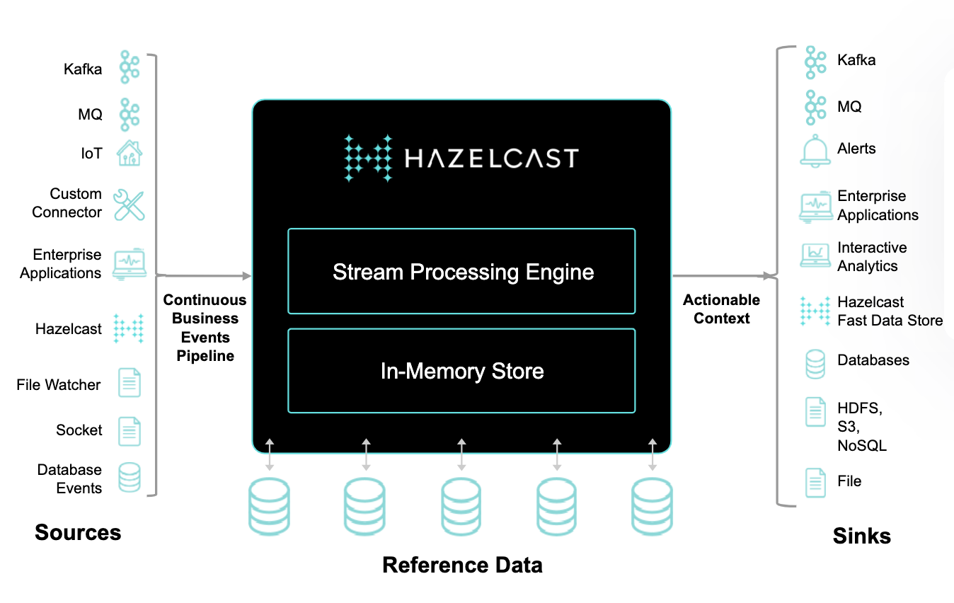
Hazelcast Company and Platform Overview
Stream Processing Reference Architecture
Source: https://hazelcast.com/products/hazelcast-platform/

Slide 10
Hazelcast IMDG in Action

Slide 11
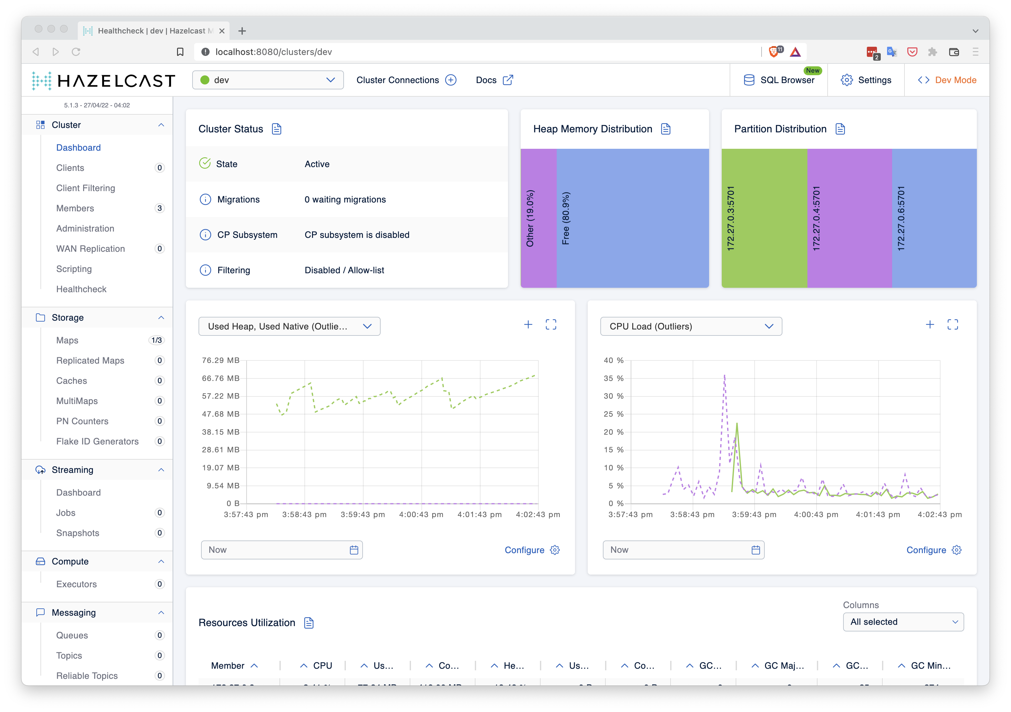
Hazelcast IMDG in Action
A short demo in which we …
Have a first look at the UI
Learn about distributed data structures in Hazelcast

Slide 12
How Hazelcast Does Event Processing

Slide 13
How Hazelcast Does Event Processing
We’ll start with the following simple scenario
Each machine sends a a set of metrics every second, including bit temperature. We want to do the following:
For machines from a particular manufacturer
Every 20 seconds, compute the average temperature over the past 20 second window.
If this average exceeds the allowable limit for that manufacturer, raise an alarm.
Scenario

Slide 14
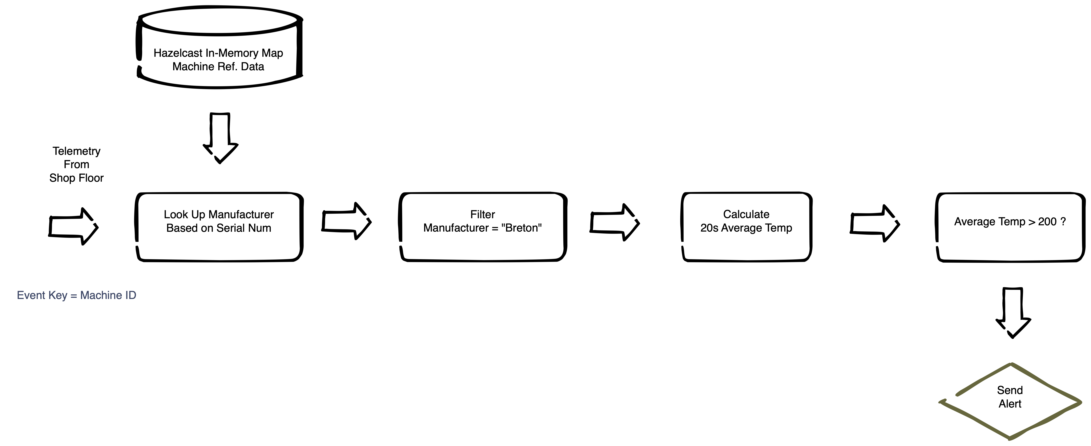
How Hazelcast Does Event Processing
Terminology
The job can be understood as a series of simple steps. This is the idea of event processing, but there are significant issues around implementing at scale. For now, notice the following:
Each simple step is a node. Nodes can filter, aggregate and do many other things.
Events flow along vertices. The events coming out of a node may be of a different number and type from the events going in.
Designating a key provides information about how a job can be parallelized.

Slide 15
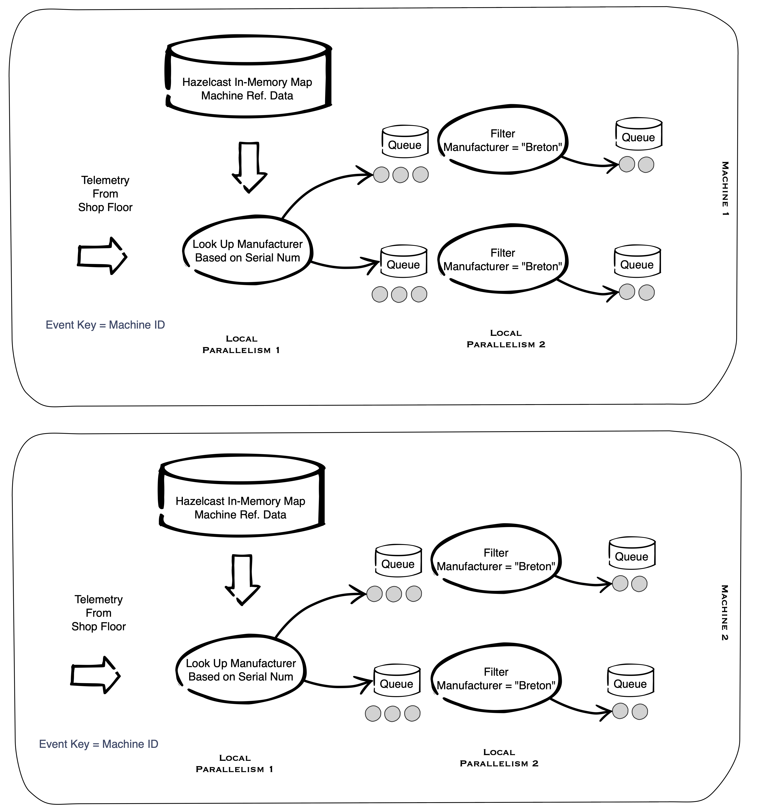
How Hazelcast Does Event Processing
The java pipeline definition is compiled to a DAG of connected “tasklets”.
Each tasklet has an input queue from which it reads events and an output queue, which is the input for the next tasklet in the pipeline.
Multiple copies of tasklets are created according to “local parallelism”
This “physical DAG” is created on each node of the cluster.
Hazelcast uses a “cooperative multi-threading” strategy to keep all threads busy running tasklets. Blocking operations are run on a separate thread pool.
A back pressure mechanism ensures that light and quick tasks do not overwhelm the input queue of heavier, slower tasks.
See https://docs.hazelcast.com/hazelcast/5.1/architecture/distributed-computing#cooperative-execution-engine for more detail.
Scalability and Parallel Execution

Slide 16
How Hazelcast Does Event Processing
Managing Parallel Execution
Generally, execution is parallelized by the provided key (serial number in the example).
When we are aggregating by something other than the key, then we cannot be fully parallel. Hazelcast takes care of data shuffling as needed.
Scalability and Parallel Execution

Slide 17
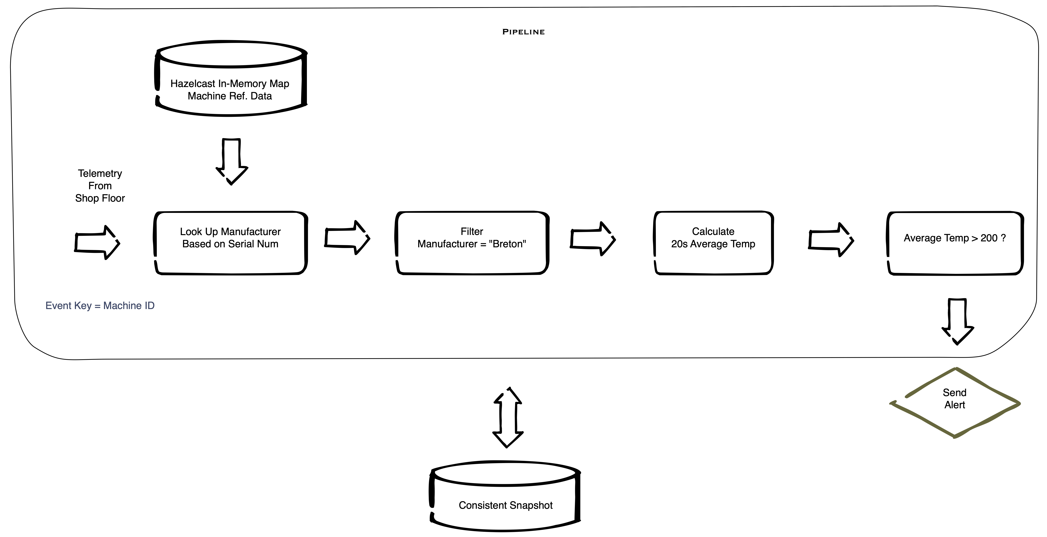
How Hazelcast Does Event Processing
Pipelines have state
Which events have been consumed
Totals so far for windows
Arbitrary state in stateful transforms
Periodically, Hazelcast creates a consistent snapshot of the entire pipeline.
In the event of failure, the whole pipeline is restarted from the latest snapshot.
This same mechanism enables updating jobs without restart or event loss
Fault Tolerance and Updates

Slide 18
How Hazelcast Does Event Processing
Developers only need to implement business logic
Hazelcast Platform automatically handles
Scaling
Fault Tolerance
Dynamic Updates
Summary

Slide 19
Hazelcast Event Processing Demonstration

Slide 20
Hazelcast Event Processing Demonstration
Terminology
The job can be understood as a series of simple steps. This is the idea of event processing, but there are significant issues around implementing at scale. For now, notice the following:
Each simple step is a node. Nodes can filter, aggregate and do many other things.
Events flow along vertices. The events coming out of a node may be of a different number and type from the events going in.
Designating a key provides information about how a job can be parallelized.

Slide 21
Hazelcast Event Processing Demonstration

Slide 22
Open Discussion and Next Steps

Slide 23
Open Discussion and Next Steps
Questions or Comments ?
Next Steps – how can we help ?
Additional presentations to other constituents
Equip you for more internal discussions
Pilot

Slide 24

Thank You!

